Slide 1


Exposure CS 2021
for CS1
Chapter 8
Output Slides
For Teachers
PowerPoint Presentation
created by:
Mr. John L. M. Schram
and Mr. Leon Schram
Authors of Exposure
Computer Science

Slide 2
Output Programs
These slides will present a variety of small programs. Each program has a control structure that was introduced in this chapter.
Our concern will be with the output of each program, and more importantly, developing a way to determine program output correctly for programs that involve repetition control structures.
You can expect that on quizzes and/or tests that only a program segment may be shown.

Slide 3

Teacher/Student Versions, Tablet PCs, and Inking
The “For Teachers” version of this presentation has 2 or more slides for each program.
The first slide only shows the program.
The other slide(s) show the program, worked out solution, and output.
The “For Students” version
only has 1 slide for each
program with no provided
solution or output. Students are
expected to work out the solutions either on paper, or ideally they can “ink” directly on their laptops.

Slide 4
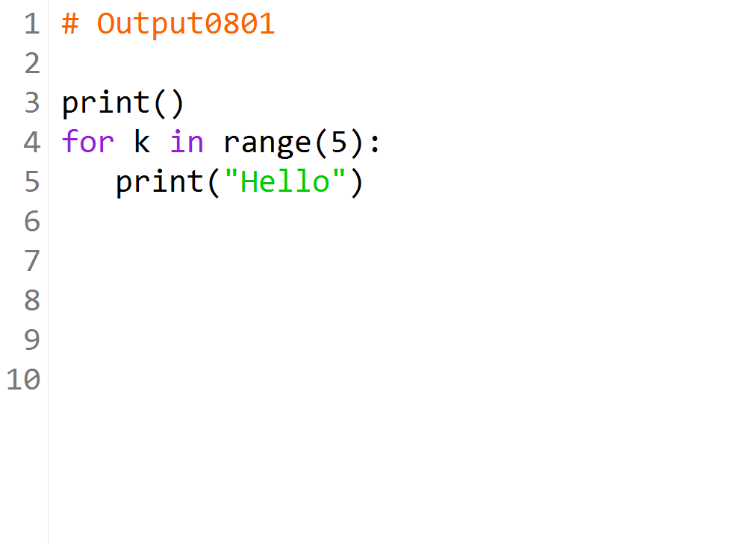

Slide 5
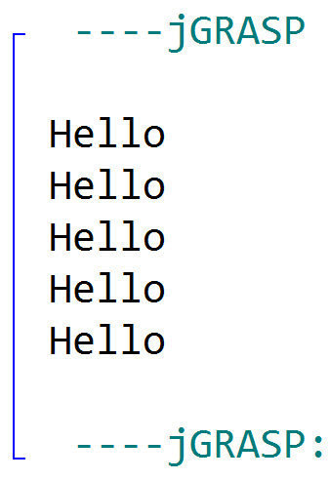

Slide 6
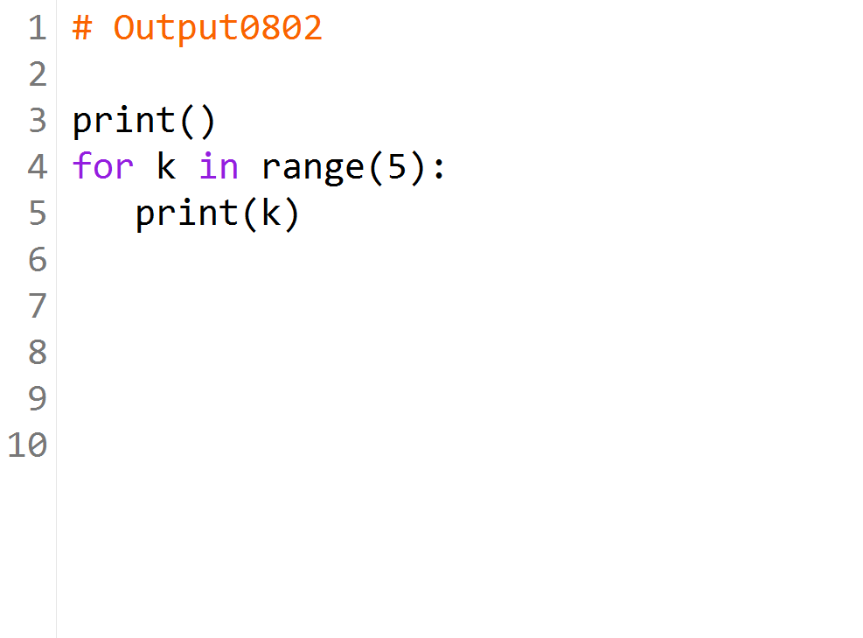

Slide 7
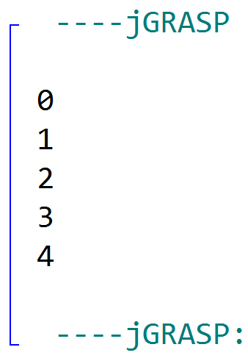

Slide 8
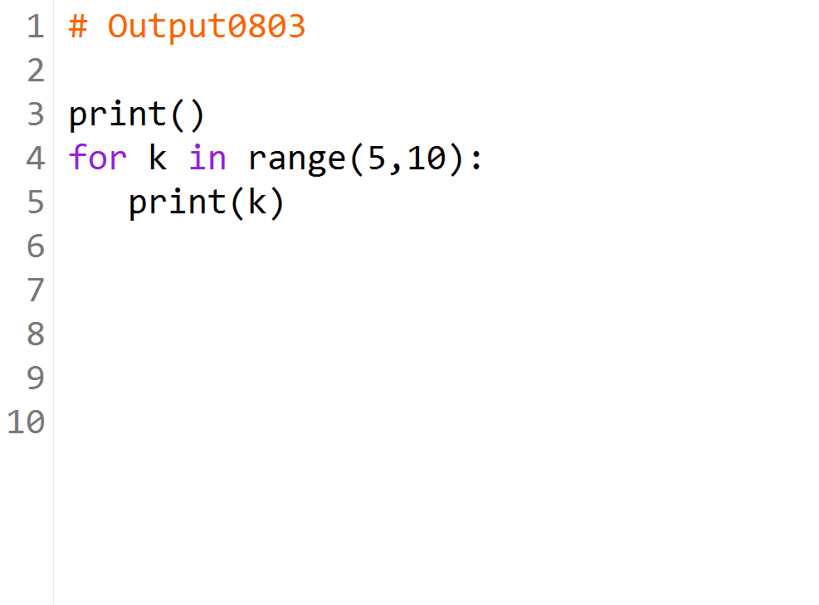

Slide 9
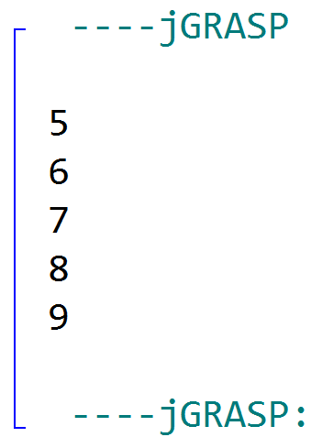

Slide 10
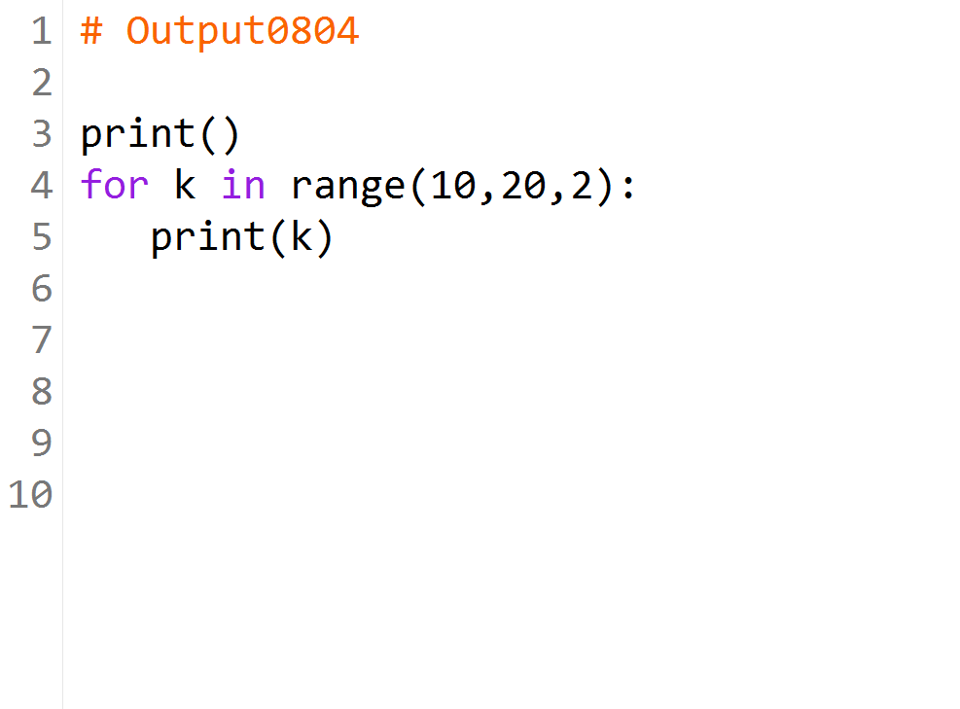

Slide 11
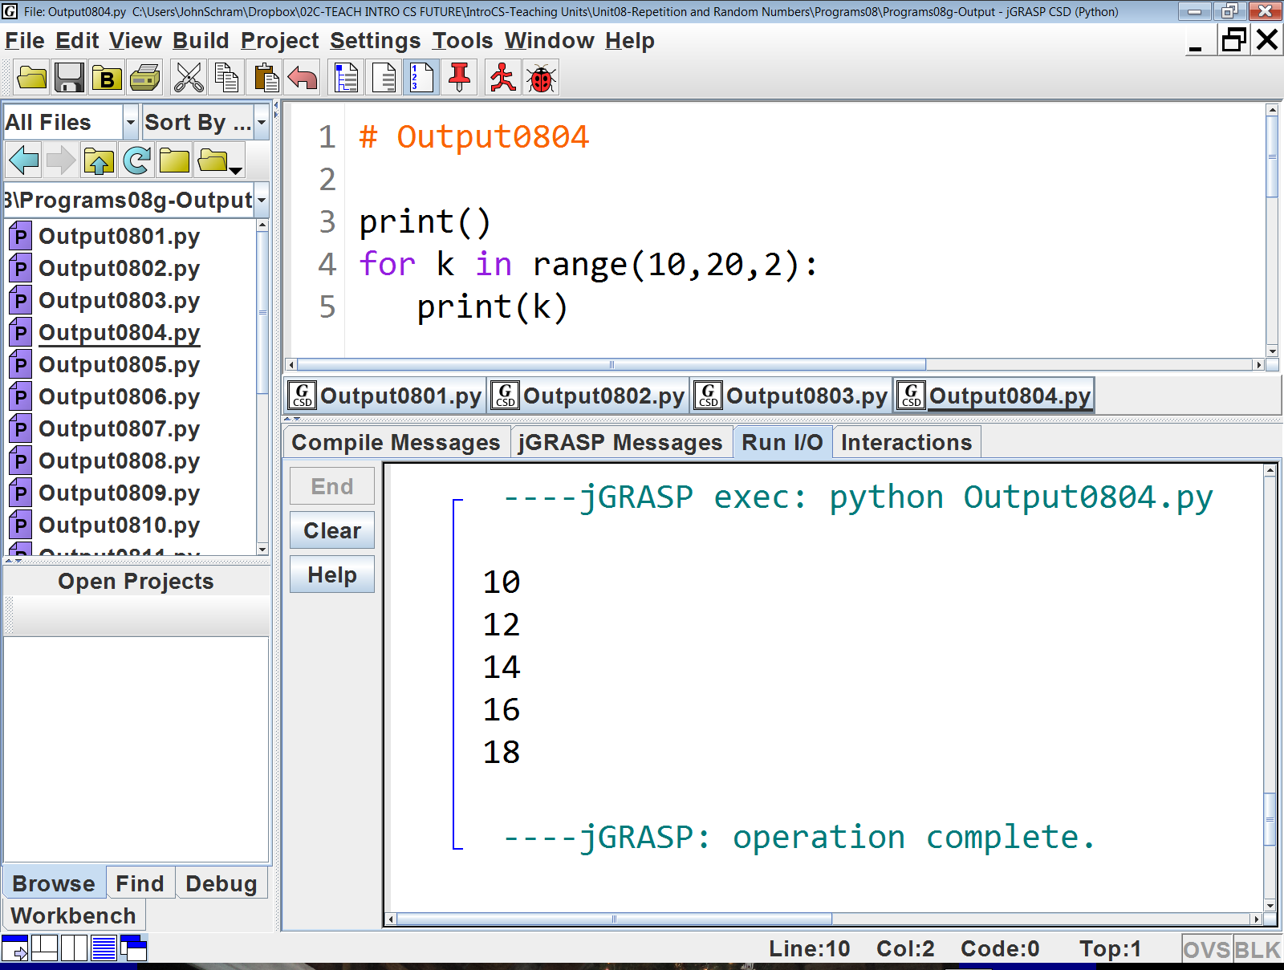

Slide 12


Slide 13
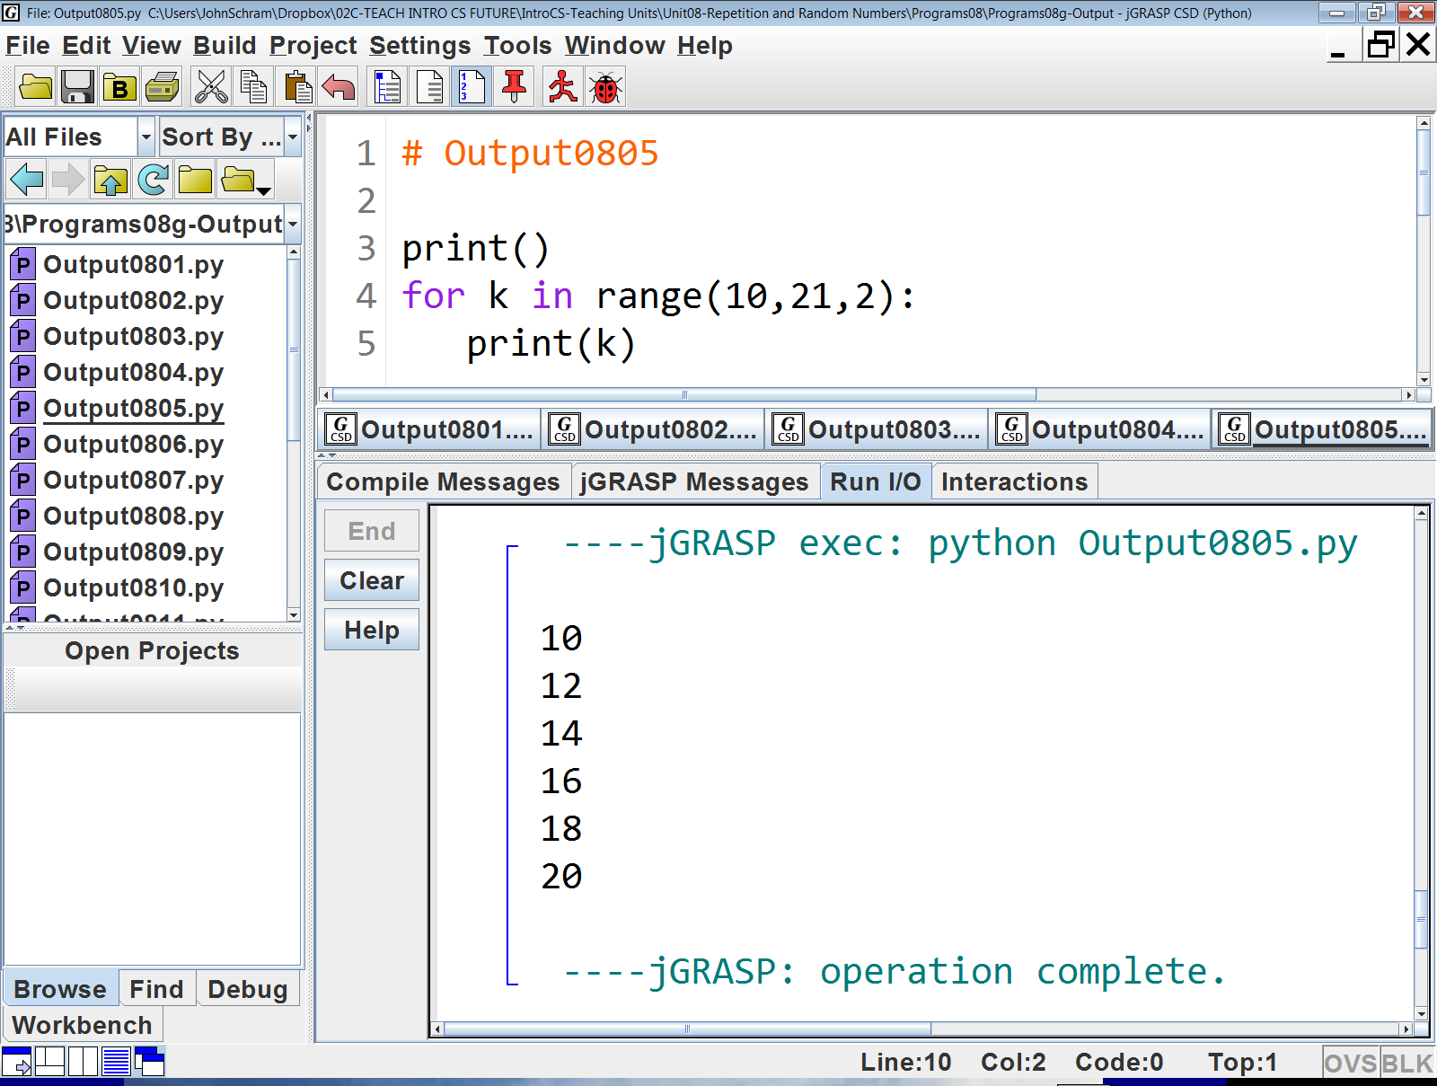

Slide 14


Slide 15
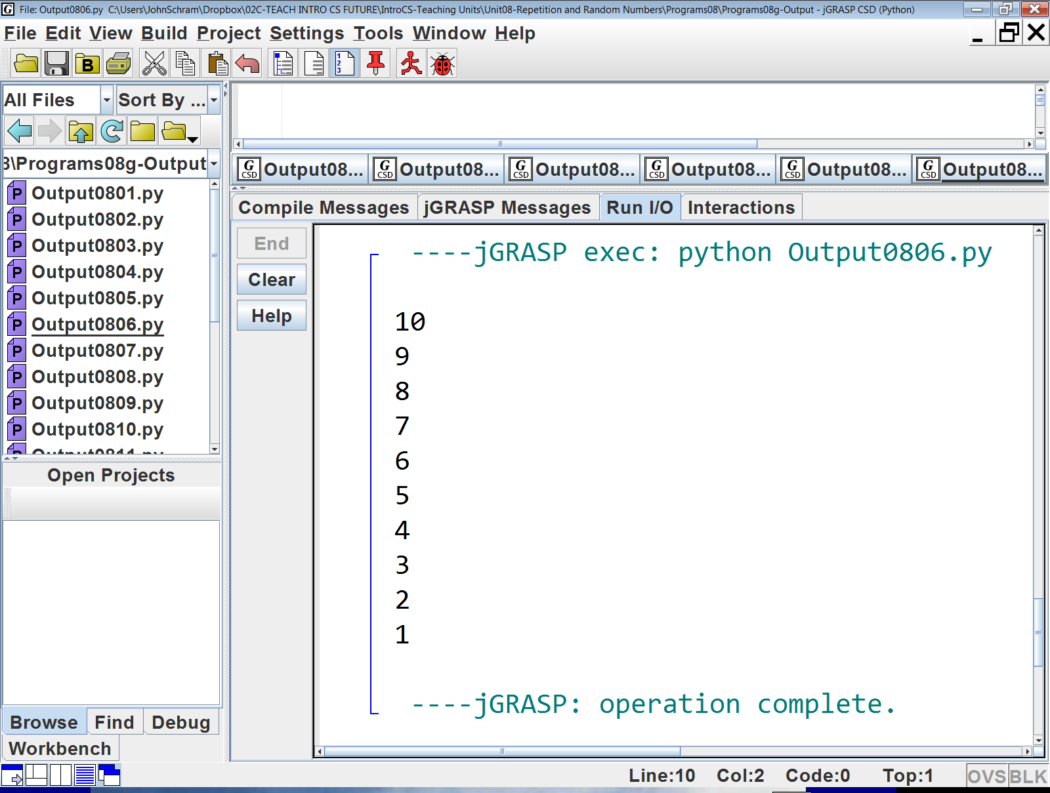

Slide 16
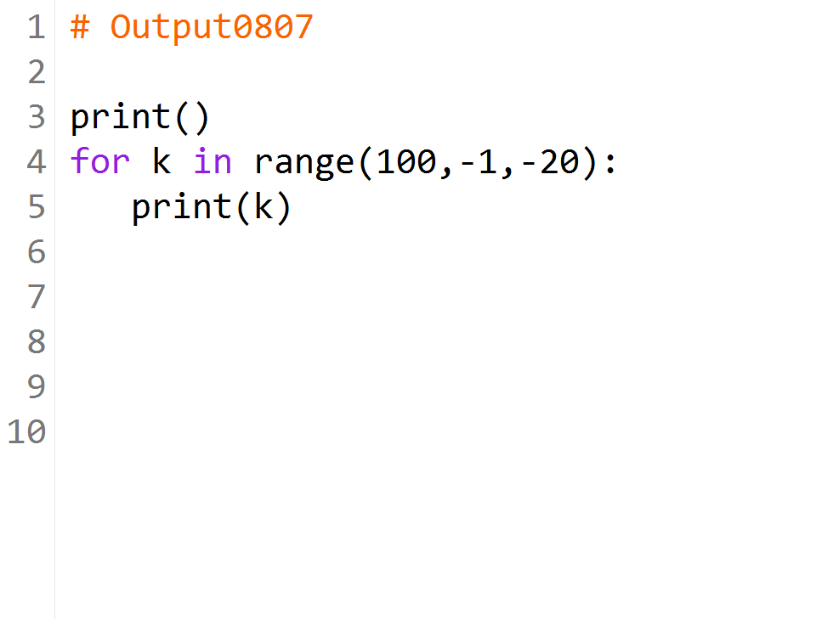

Slide 17
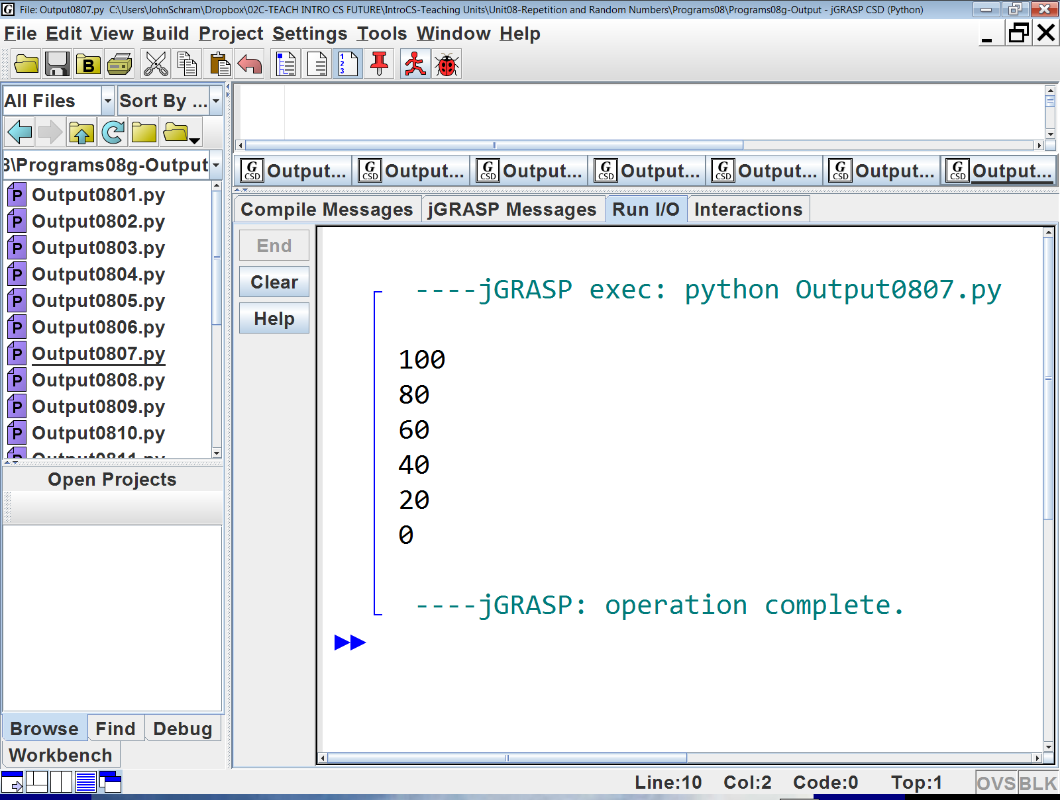

Slide 18
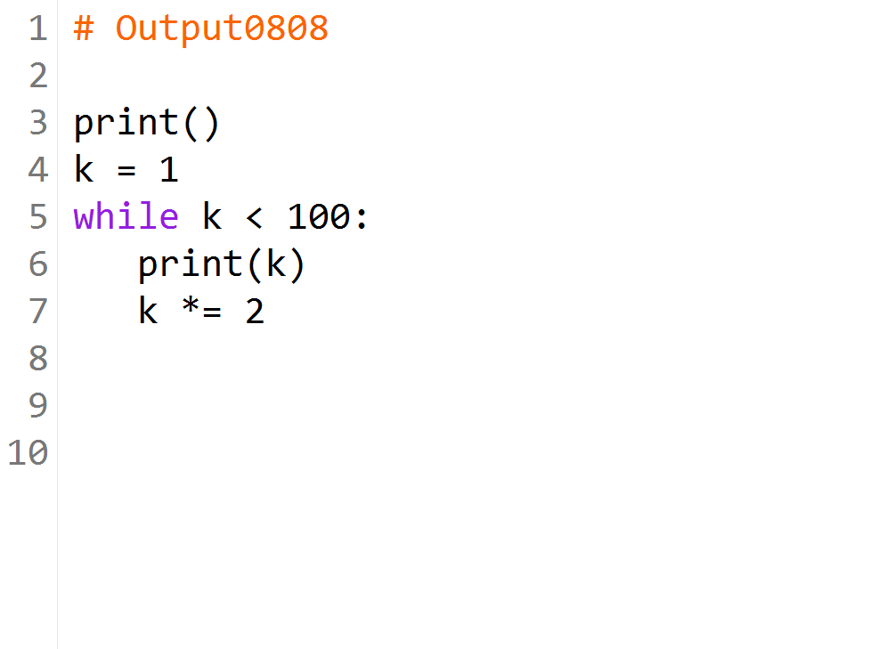

Slide 19
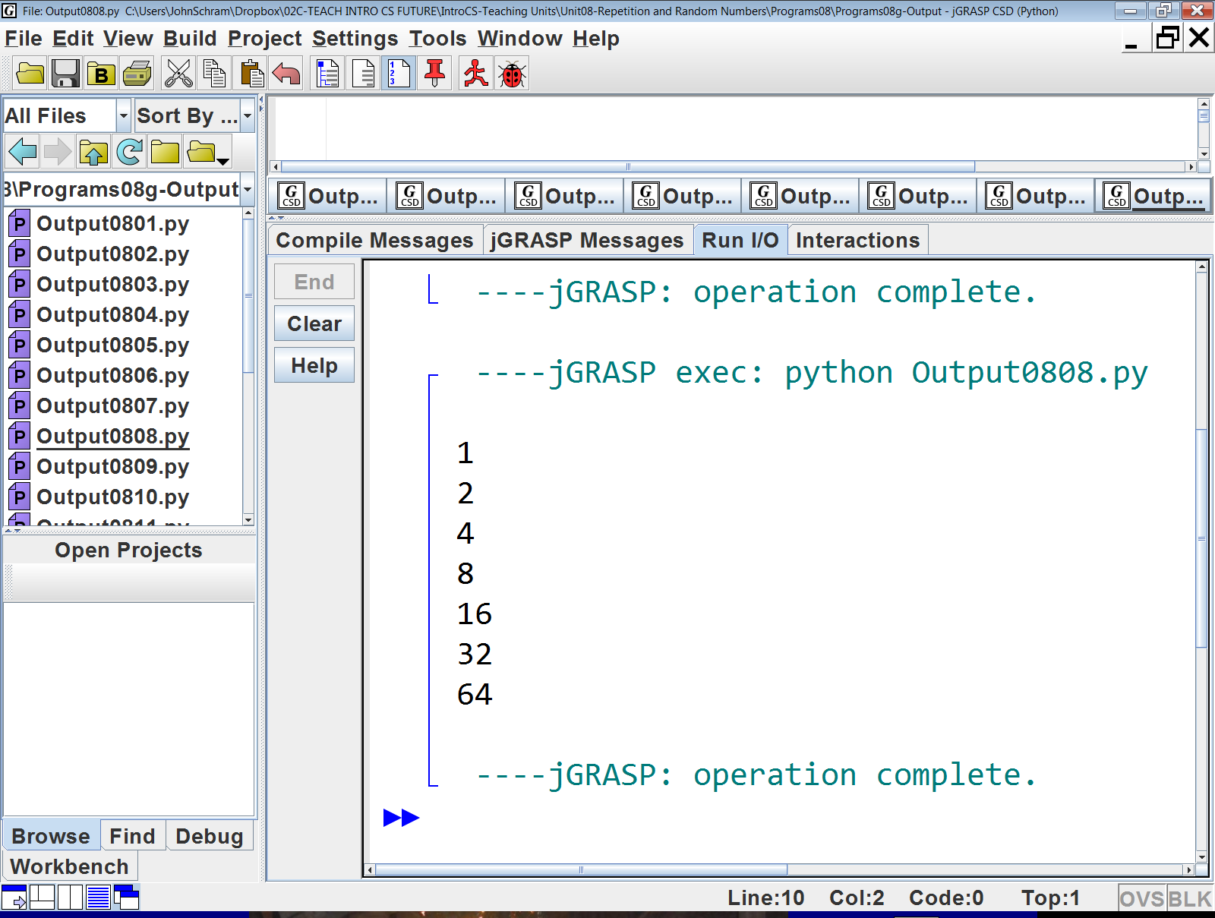

Slide 20
k | k < 100 | Output
1 | True | 1
2 | True | 2
4 | True | 4
8 | True | 8
16 | True | 16
32 | True | 32
64 | True | 64
128 | False

Slide 21


Slide 22
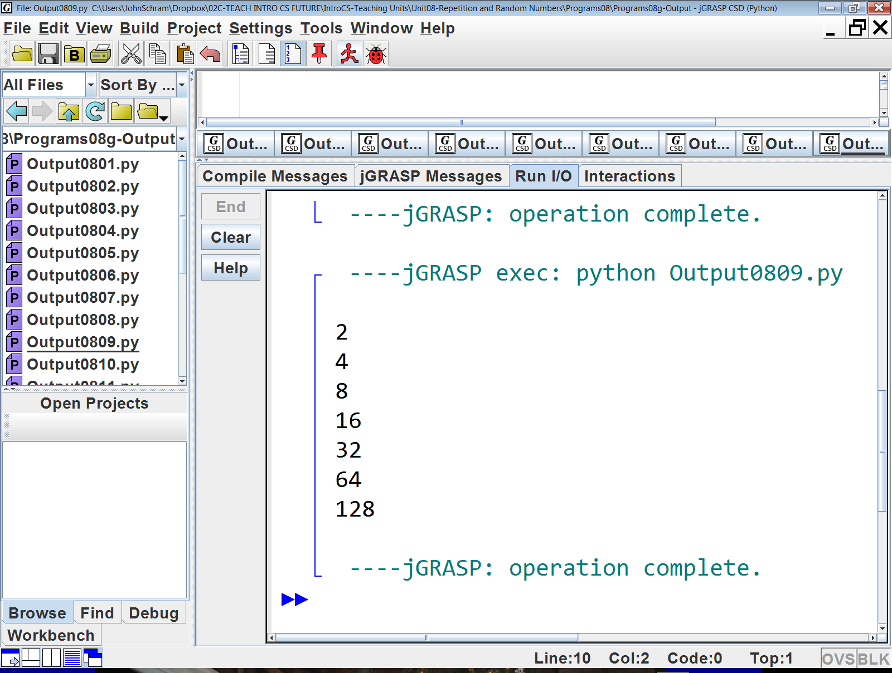

Slide 23
k | Output | k < 100
1 |  | True
2 | 2 | True
4 | 4 | True
8 | 8 | True
16 | 16 | True
32 | 32 | True
64 | 64 | True
128 | 128 | False

Slide 24
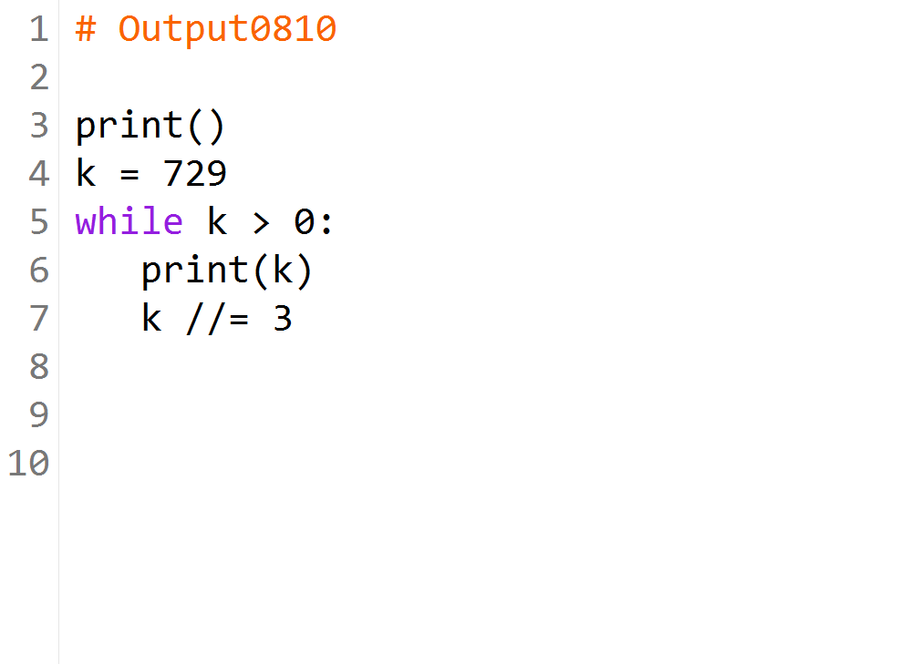

Slide 25
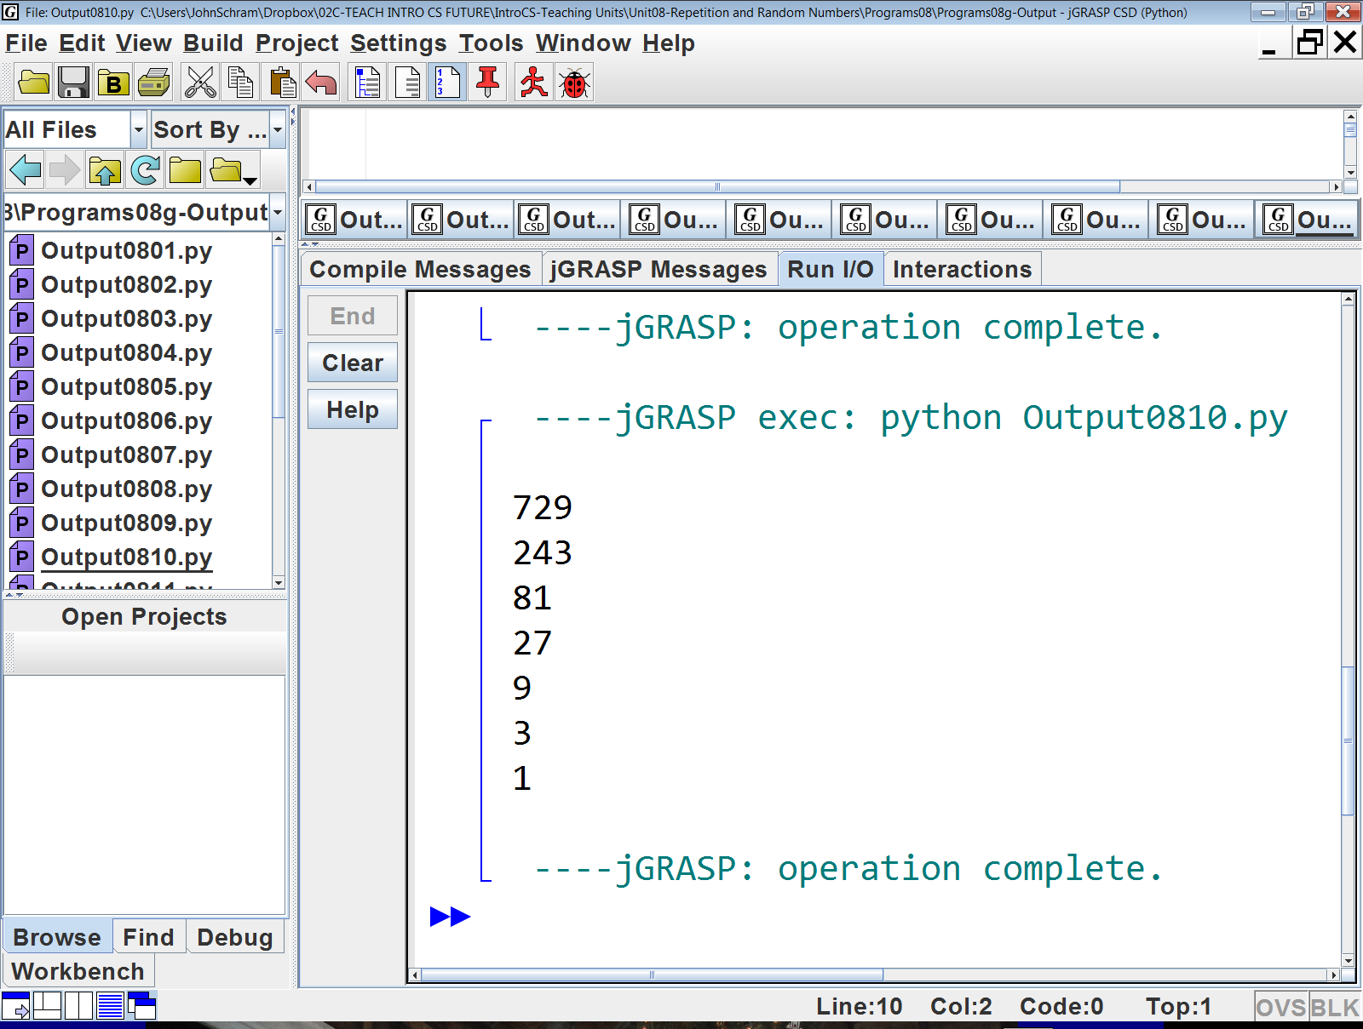

Slide 26
k | k > 0 | Output
729 | True | 729
243 | True | 243
81 | True | 81
27 | True | 27
9 | True | 9
3 | True | 3
1 | True | 1
0 | False

Slide 27
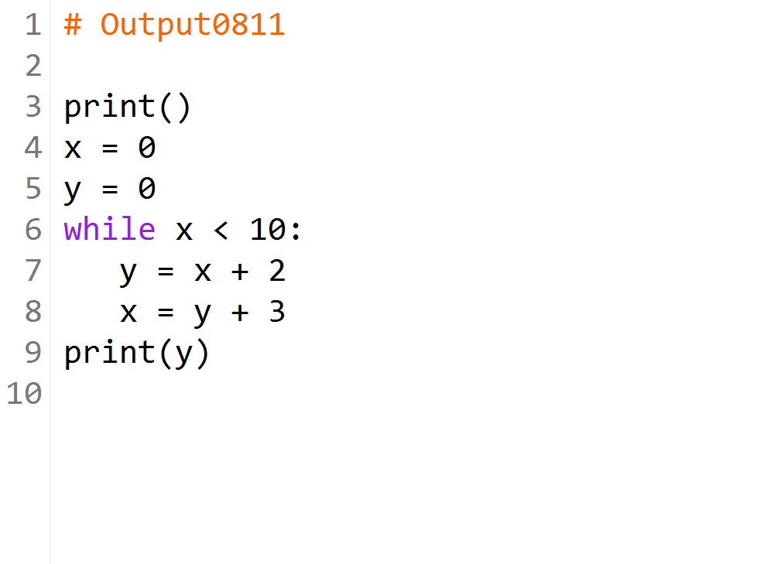

Slide 28
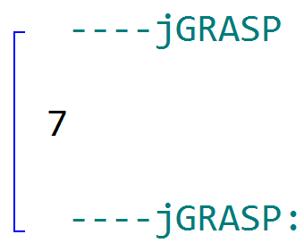

Slide 29
y | x | x < 10 | Output
0 | 0 | True
2 | 5 | True
7 | 10 | False | 7

Slide 30
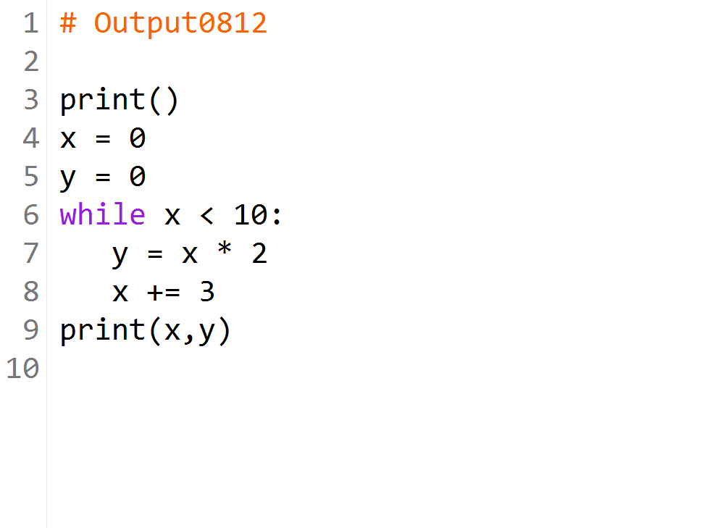

Slide 31
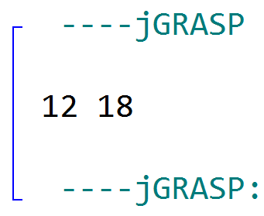

Slide 32
y | x | x < 10 | Output
0 | 0 | True
0 | 3 | True
6 | 6 | True
12 | 9 | True
18 | 12 | False | 12 18

Slide 33
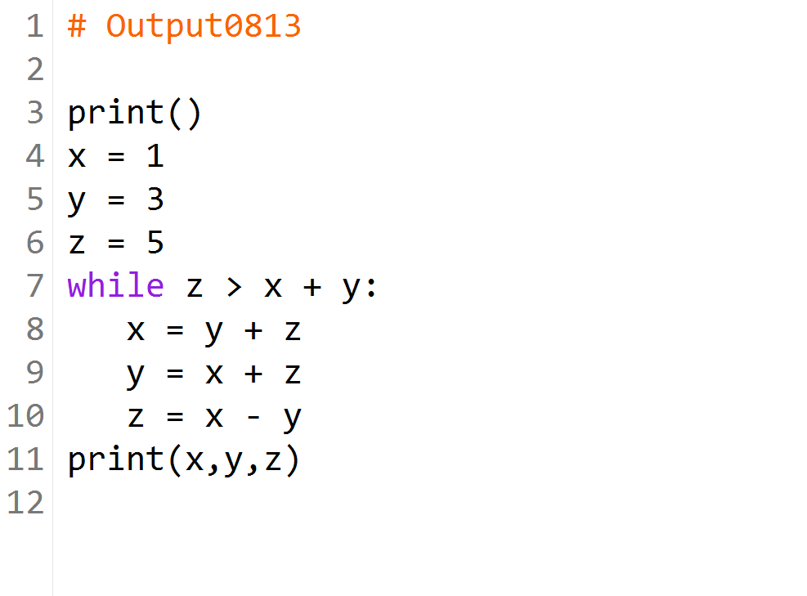

Slide 34
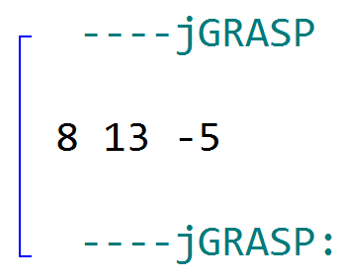

Slide 35
x | y | z | z > x + y | Output
1 | 3 | 5 | True
8 | 13 | -5 | False | 8 13 -5

Slide 36
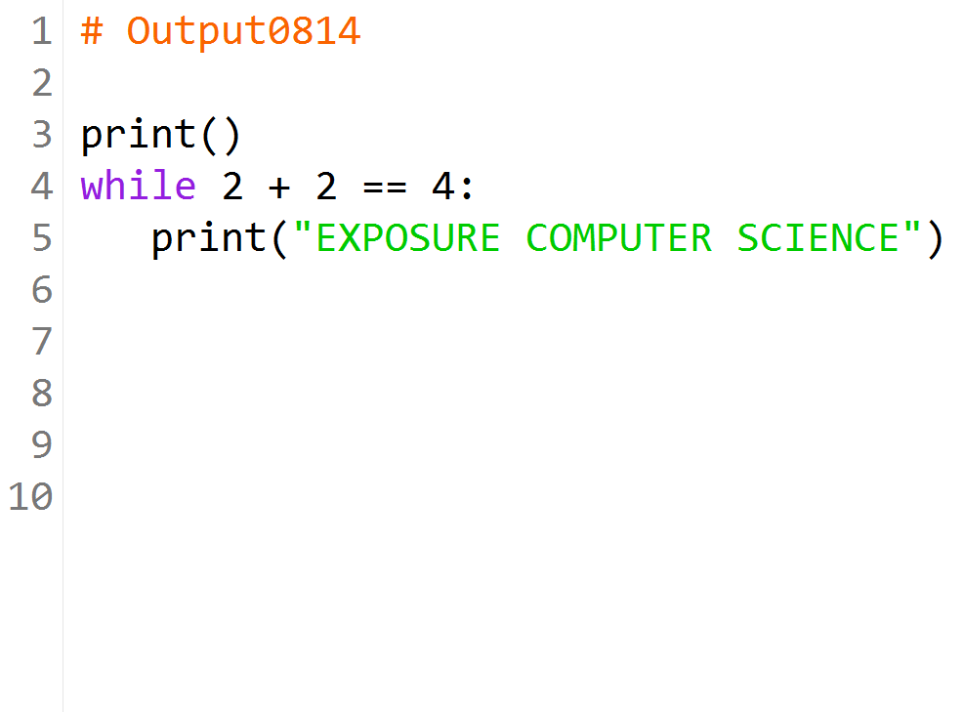

Slide 37
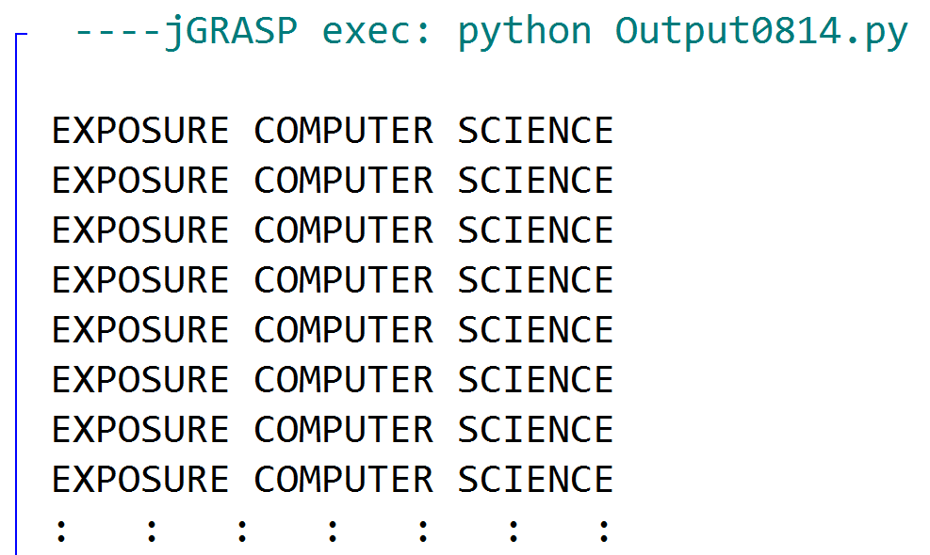
This output will continue
FOREVER because 2 + 2
will always equal 4!

Slide 38
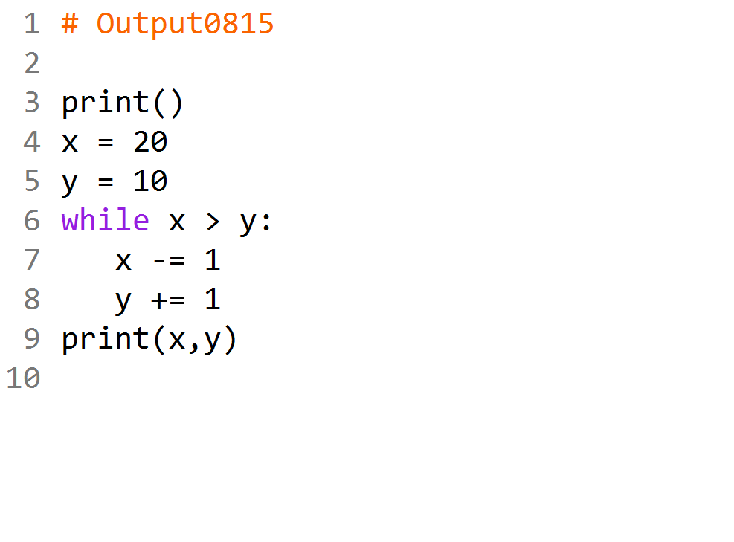

Slide 39
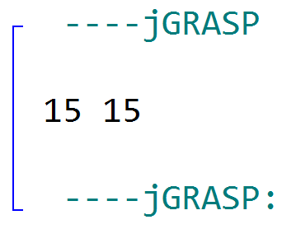

Slide 40
x | y | x > y | Output
20 | 10 | True
19 | 11 | True
18 | 12 | True
17 | 13 | True
16 | 14 | True
15 | 15 | False | 15 15

Slide 41


Slide 42
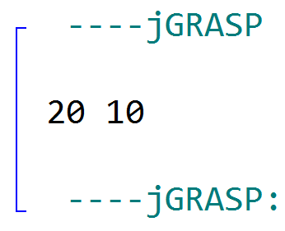

Slide 43
x | y | x < y | Output
20 | 10 | False | 20 10
Since the condition is False at the very beginning, the while loop does not execute at all.

Slide 44
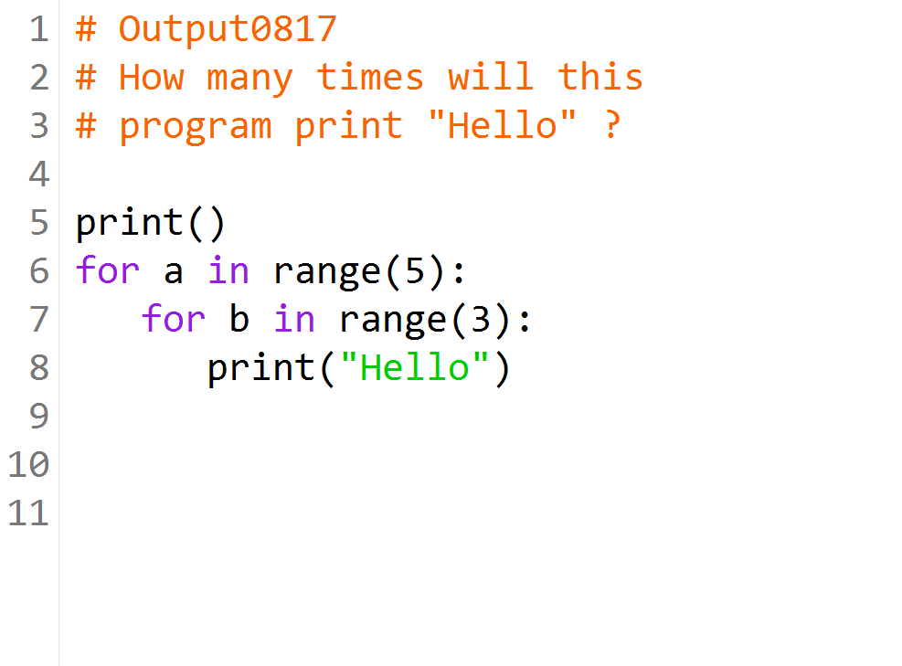

Slide 45
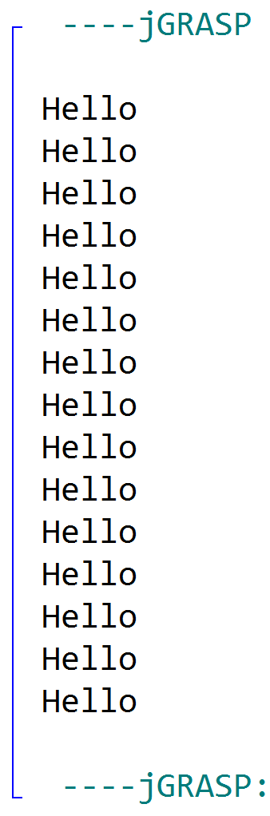
5 * 3 = 15 Hellos

Slide 46
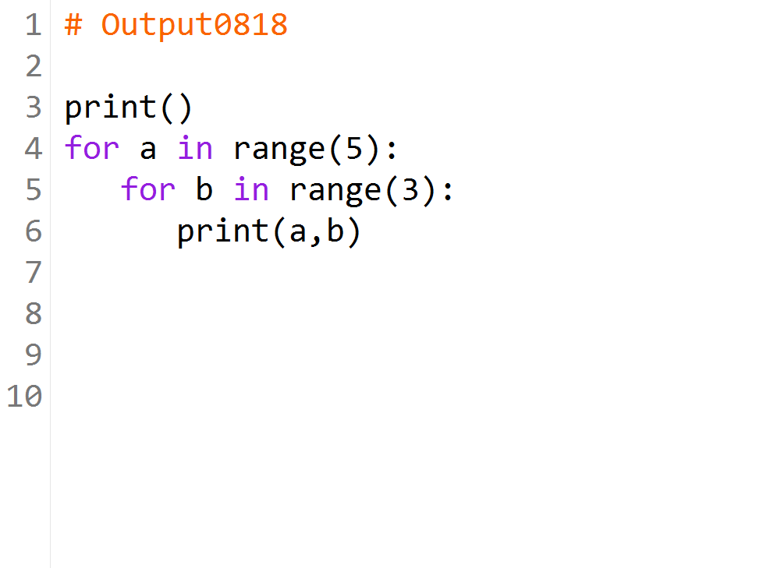

Slide 47
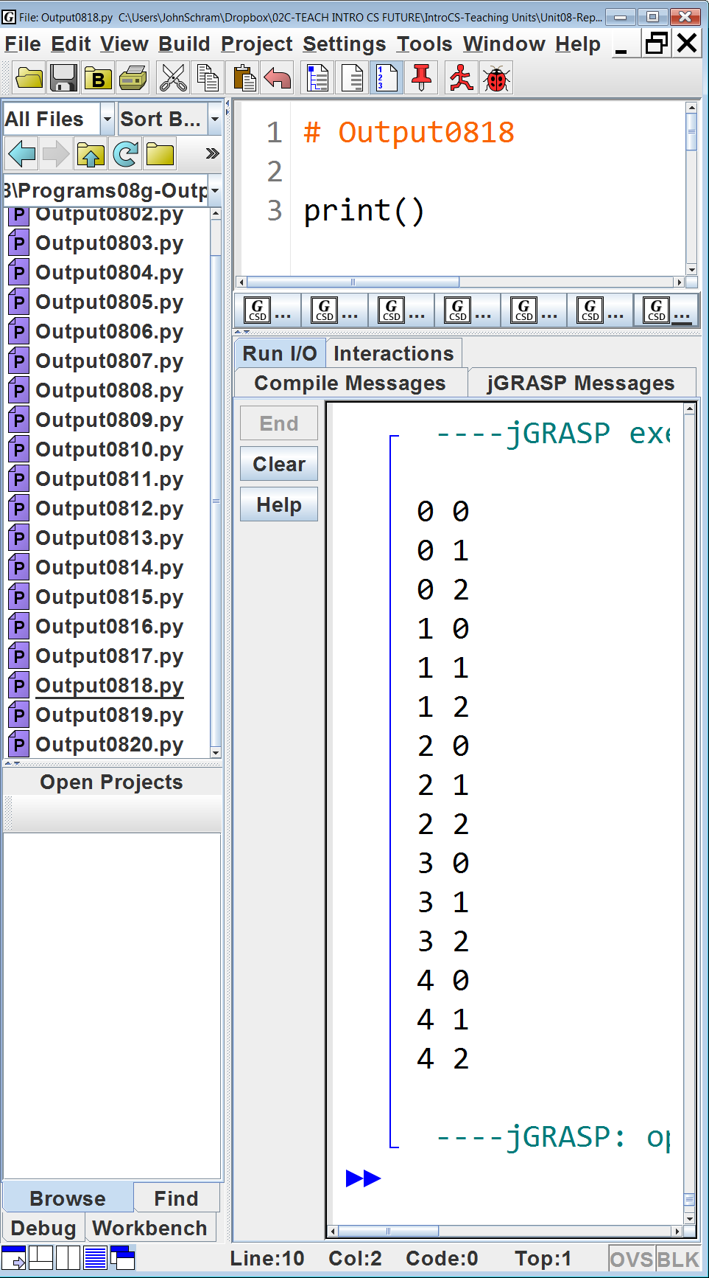

Slide 48
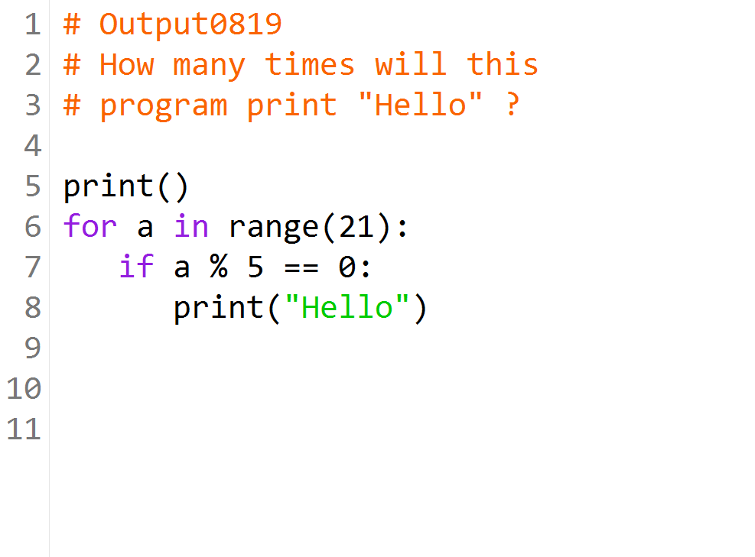

Slide 49
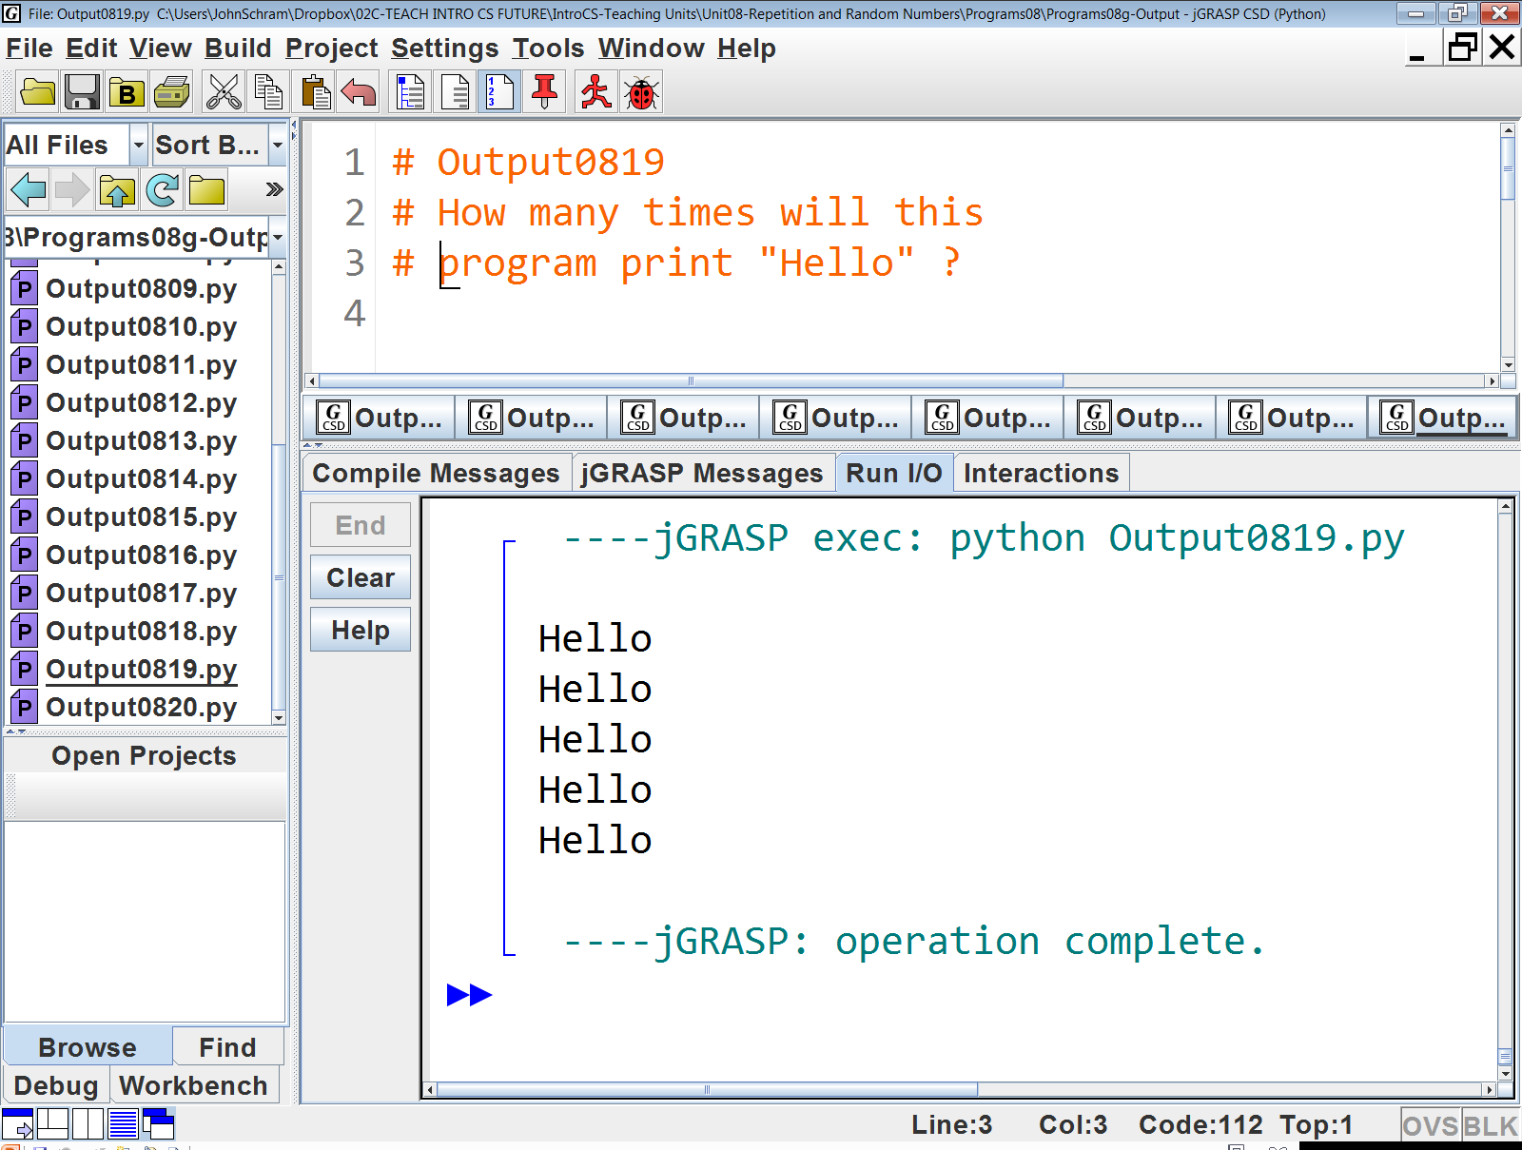

Slide 50
The if statement will only allow Hello to be printed if a is a multiple of 5.
There are 5 multiples of 5 from 0 to 20. These are 0, 5, 10, 15 and 20.

Slide 51
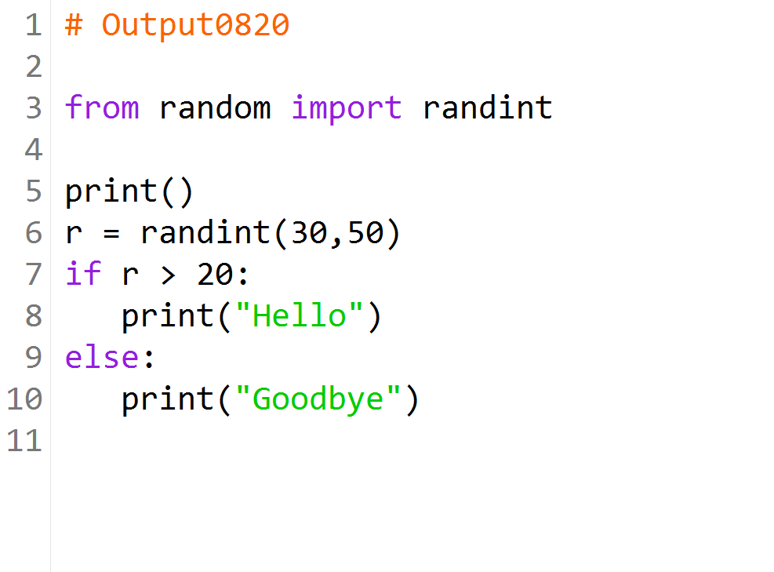

Slide 52
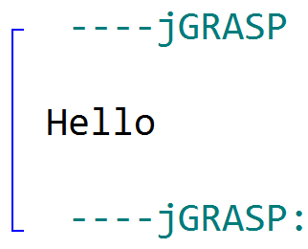

Slide 53
Even though the value of r is random, we know it still has to be > 20 because the smallest possible value it could have is 30.

